Slide 1
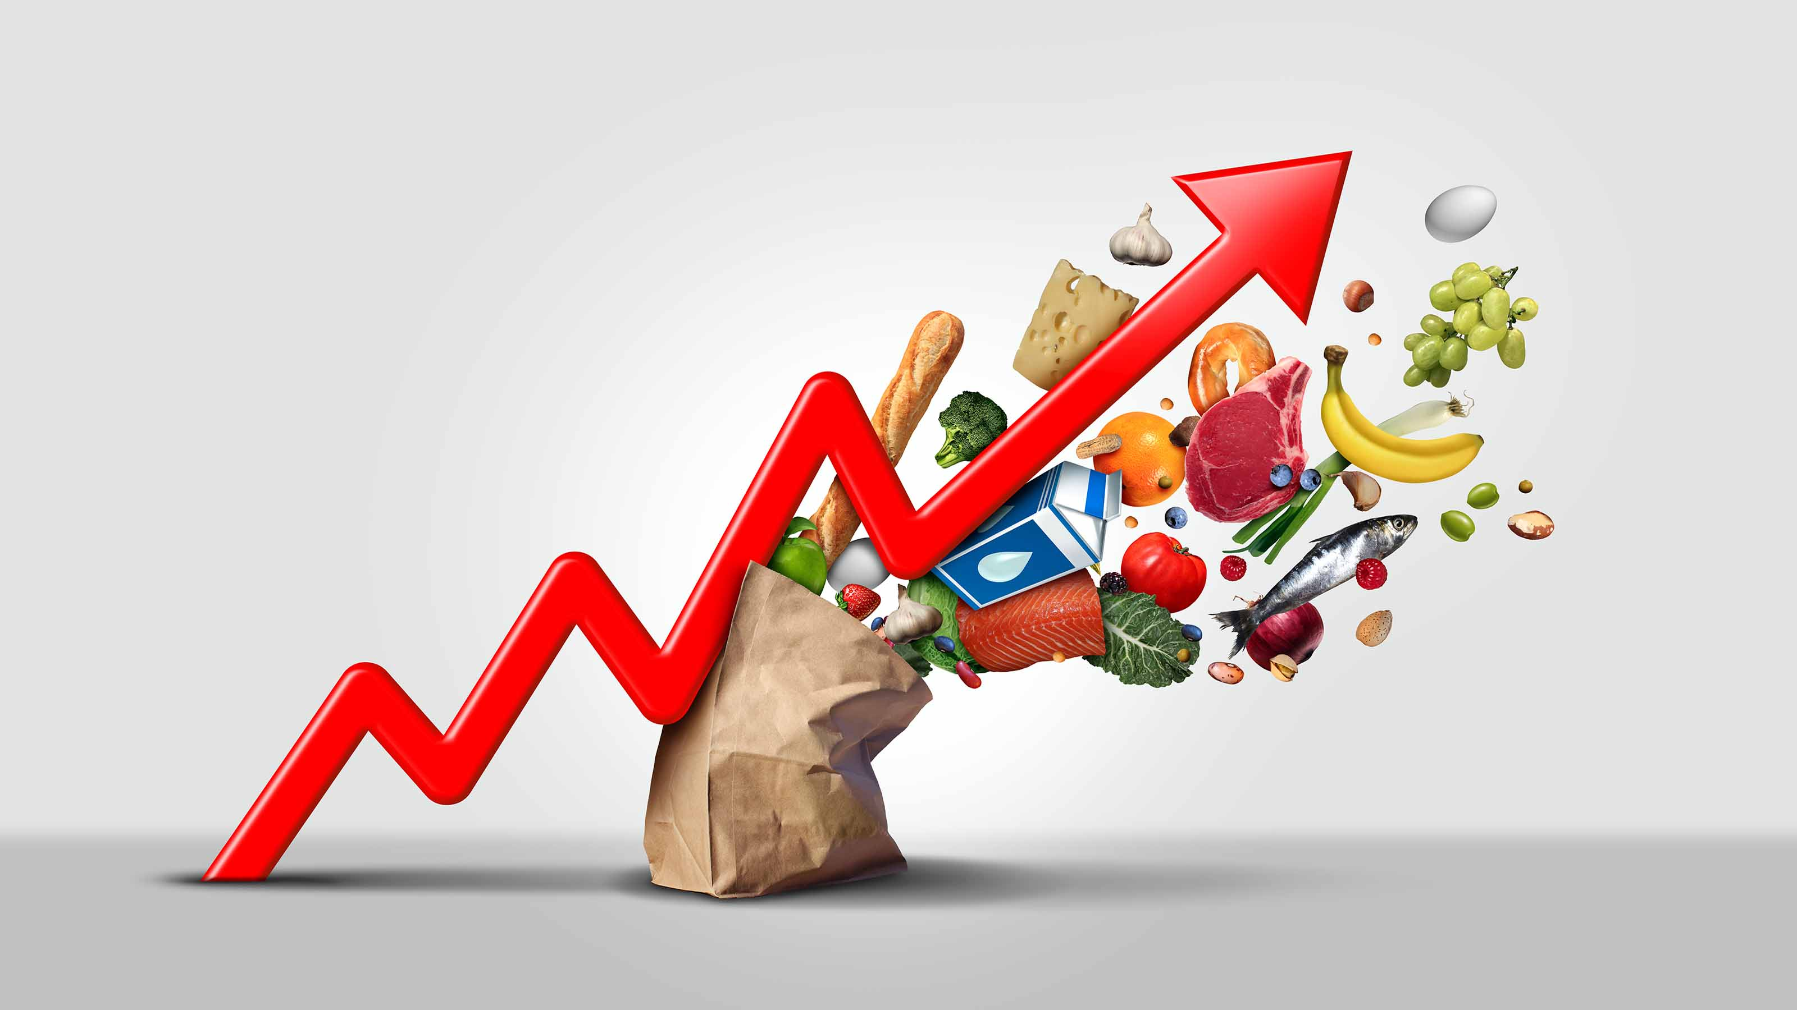
Has Inflation Reached Consumers’ Breaking Point?

Slide 2
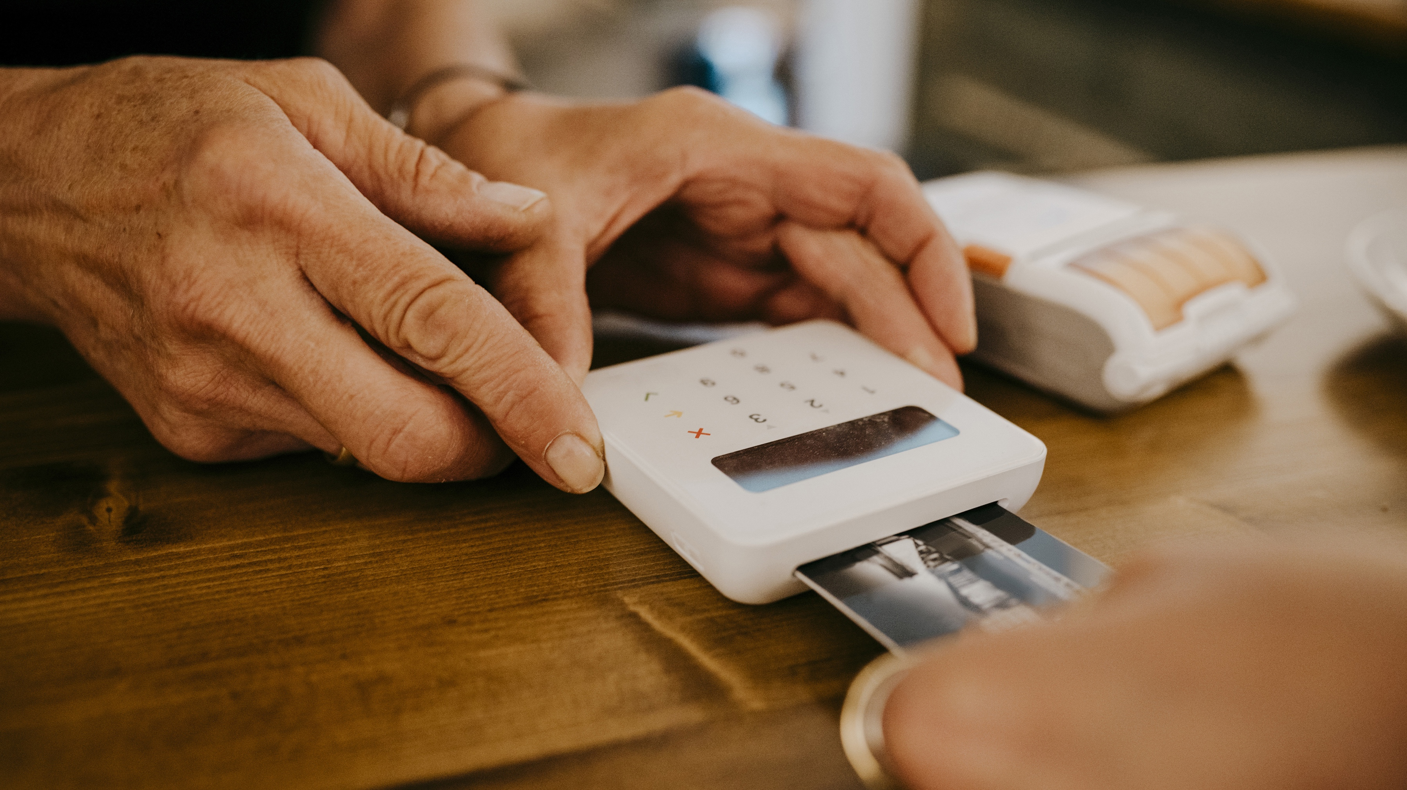



Summary
In a nutshell, we are going to discuss about the consumer backlash against persistent price hikes amidst high inflation rates.
Companies across various sectors like food, home improvement, and pet products grapple with whether to pass increased costs to consumers. Those who opt for moderate price increases fare better than those imposing larger hikes, as seen with Kraft Heinz and General Mills experiencing sales declines after significant increases.
Home Depot and Shake Shack adjusted their strategies to modest price rises, which helped maintain or improve their sales. Additionally, companies are exploring new pricing strategies like tiered offerings to cater to different consumer budgets, exemplified by Netflix and McDonald’s.
McDonald’s faces criticism for high prices, prompting a pledge to enhance affordability options, reflecting shifting consumer expectations and economic pressures.

Slide 3

Key Takeaways
Consumer Sensitivity to Price Increases
Consumers are increasingly sensitive to price hikes, especially in a high-inflation environment. Companies need to carefully consider how much and how frequently they raise prices to avoid losing customers
Strategic Pricing Decisions
pricing decisions should be strategic and based on thorough understanding of market dynamics, consumer behavior, and competitive landscape. This ensures that companies can navigate economic challenges while maintaining profitability and customer satisfaction.
Responsive Marketing
Companies like McDonald’s are responsive to consumer feedback and social media sentiments regarding pricing. This responsiveness is crucial for maintaining brand loyalty and addressing consumer complaints effectively.
Impact of Pricing Strategies on Sales
Companies that implement moderate price increases tend to fare better in terms of sales performance compared to those that impose significant price hikes. This underscores the importance of strategic pricing decisions aligned with consumer willingness to pay.

Slide 4

Questions
If you were advising a restaurant retailer, how would you recommend it deal with continued high prices for its materials?
Have you changed your consumption habits, due to continued price increases?

Slide 5

Questions
Have you changed your consumption habits, due to continued price increases?
Answer: Yes. This is because Consumers including myself may opt for cheaper alternatives or private-label brands to save money. Non-essential purchases such as dining out or entertainment may decrease as consumers prioritize essentials.

